Slide 1
Constraint Satisfaction Problems (CSPs)
Chapter 6

Slide 2
Outline
Constraint Satisfaction Problems (CSP)
Backtracking search for CSPs
Local search for CSPs

Slide 3
What is a CSP
Finite set of variables X₁, X₂, …, X_{n}
Nonempty domain of possible values for each variable D₁, D₂, …, D_{n}
Finite set of constraints C₁, C₂, …, C_{m}
Each constraint C_{i} limits the values that variables can take,
e.g., X₁ ≠ X₂
Each constraint C_{i} is a pair <scope, relation>
Scope = Tuple of variables that participate in the constraint.
Relation = List of allowed combinations of variable values.
May be an explicit list of allowed combinations.
May be an abstract relation allowing membership testing and listing.

Slide 4
Example: 8-Queens
Variables: Queens, one per column
Q1, Q2, …, Q8
Domains: row placement, {1,2,…,8}
Constraints:
Qi != Qj (j != i)
|Qi – Qj| != |i – j|

Slide 5
CSP – What is a Solution?
A state is an assignment of values to some or all variables.
An assignment is complete when every variable has a value.
An assignment is partial when some variables have no values.
Consistent assignment
assignment does not violate the constraints
A solution to a CSP is a complete and consistent assignment.
Some CSPs require a solution that maximizes an objective function.

Slide 6
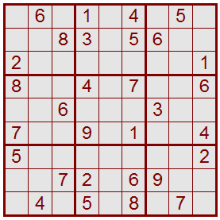
Sudoku as a CSP
Variables: 81 variables
A1, A2, A3, …, I7, I8, I9
Letters index rows, top to bottom
Digits index columns, left to right
Domains: The nine positive digits
A1 ∈ {1, 2, 3, 4, 5, 6, 7, 8, 9}
Etc.
Constraints: 27 Alldiff constraints
Alldiff(A1, A2, A3, A4, A5, A6, A7, A8, A9)
Etc.
1 2 3 4 5 6 7 8 9
A
B
C
D
E
F
G
H
I

Slide 7
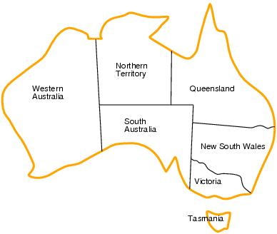
Example: Map coloring
Variables: WA, NT, Q, NSW, V, SA, T
Domains: D_{i}={red, green, blue}
Constraints: adjacent regions must have different colors.
e.g. WA ≠ NT

Slide 8
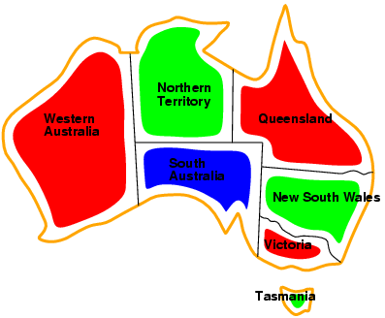
Example: Map-Coloring
Solutions are complete and consistent assignments, e.g., WA = red, NT = green,Q = red,NSW = green,V = red,SA = blue,T = green

Slide 9
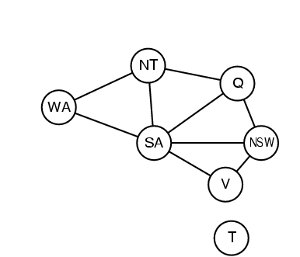
Constraint graph
Binary CSP: each constraint relates two variables
Constraint graph: nodes are variables, arcs are constraint

Slide 10
Incremental formulation
Initial state : empty assignment in which all variables are unassigned
Successor fn : assign a value to a variable so that it does not conflict with other variables
Goal test : current assignment is complete
Path cost : a constant cost (e.g. 1) for every step.

Slide 11
Varieties of CSPs
Discrete variables
finite domains:
n variables, domain size d → O(d^{n}) complete assignments
infinite domains:
integers, strings, etc.
e.g., job scheduling, variables are start/end days for each job
need a constraint language, e.g., StartJob₁ + 5 ≤ StartJob₃
Continuous variables
e.g., start/end times for Hubble Space Telescope observations
linear constraints solvable in polynomial time by linear programming

Slide 12
Varieties of constraints
Unary constraints involve a single variable,
e.g., SA ≠ green
Binary constraints involve pairs of variables,
e.g., SA ≠ WA
Higher-order constraints involve 3 or more variables,
e.g., cryptarithmetic column constraints

Slide 13
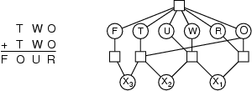
Example: Cryptarithmetic
Variables: F T U W R O X₁ X₂ X₃
Domains: {0,1,2,3,4,5,6,7,8,9}
Constraints: Alldiff (F,T,U,W,R,O)
O + O = R + 10 · X₁
X₁ + W + W = U + 10 · X₂
X₂ + T + T = O + 10 · X₃
X₃ = F, T ≠ 0, F ≠ 0

Slide 14
Real-world CSPs
Assignment problems
e.g., who teaches what class
Timetabling problems
e.g., which class is offered when and where?
Transportation scheduling
Factory scheduling
Notice that many real-world problems involve real-valued variables

Slide 15
Standard search formulation (incremental)
Let's start with the straightforward approach, then fix it States are defined by the values assigned so far Initial state: the empty assignment { }
Successor function: assign a value to an unassigned variable that does not conflict with current assignment
fail if no legal assignments
Goal test: the current assignment is complete
This is the same for all CSPs
Every solution appears at depth n with n variables → use depth-first search
Path is irrelevant, so can also use complete-state formulation

Slide 16
Backtracking search
Variable assignments are commutative}, i.e.,
[ WA = red then NT = green ] same as [ NT = green then WA = red ]
Only need to consider assignments to a single variable at each node
Depth-first search for CSPs with single-variable assignments is called backtracking search
Backtracking search is the basic uninformed algorithm for CSPs
Can solve n-queen problem for n ≈ 25

Slide 17
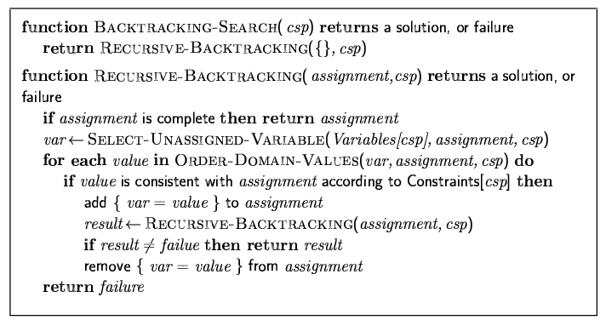
Backtracking search

Slide 18

Backtracking example

Slide 19
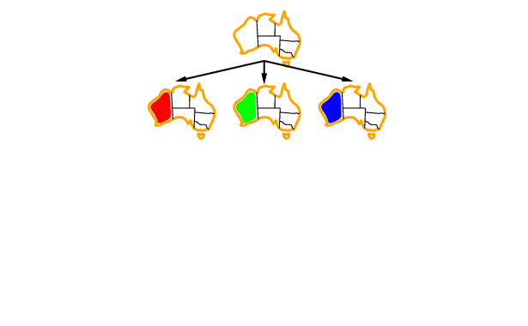
Backtracking example

Slide 20
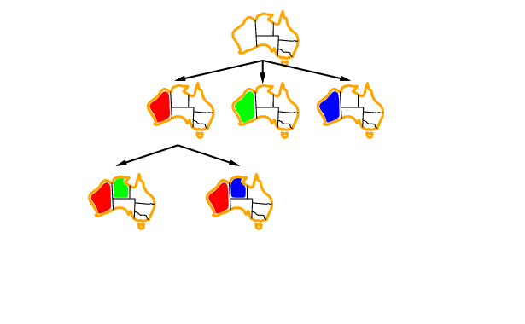
Backtracking example

Slide 21
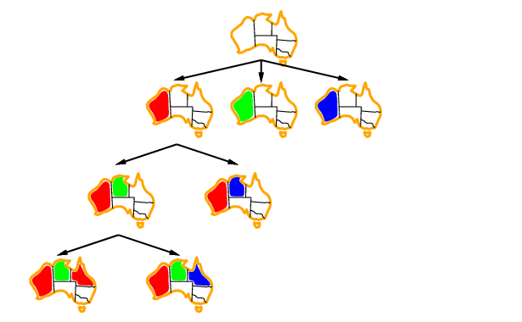
Backtracking example

Slide 22
Improving backtracking efficiency
General-purpose methods can give huge gains in speed:
Which variable should be assigned next?
In what order should its values be tried?
Can we detect inevitable failure early?

Slide 23
Backtracking search
SELECT-UNASSIGNED-VARIABLE
Minimum Remaining Values (MRV)
Most constrained variable
Most likely to fail soon (so prunes pointless searches)
If a tie (such as choosing the start state), choose the variable involved in the most constraints (degree heuristic) E.g., in the map example, SA adjacent to the most states.
Reduces branching factor, since fewer legal successors of that node

Slide 24

Most constrained variable
Most constrained variable:
choose the variable with the fewest legal values
a.k.o. minimum remaining values (MRV) heuristic

Slide 25

Most constraining variable
Tie-breaker among most constrained variables
Most constraining variable:
Select variable involved in the most constraints on other unassigned variables
Useful as a tie-breaker among most constrained variables

Slide 26
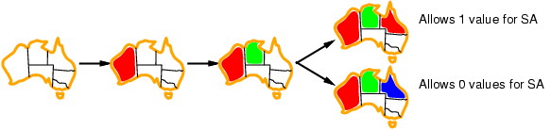
Least constraining value
Given a variable, choose the least constraining value:
Rules out the fewest choices for the variables it is in constraints with
Leave the maximum flexibility
Combining these heuristics makes 1000 queens feasible

Slide 27
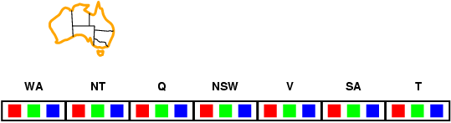
Forward checking
Idea:
Keep track of remaining legal values for unassigned variables
Terminate search when any variable has no legal values

Slide 28
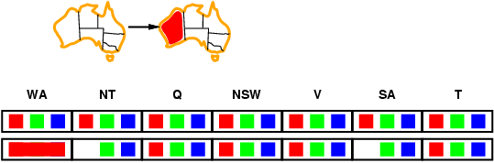
Forward checking
Idea:
Keep track of remaining legal values for unassigned variables
Terminate search when any variable has no legal values

Slide 29
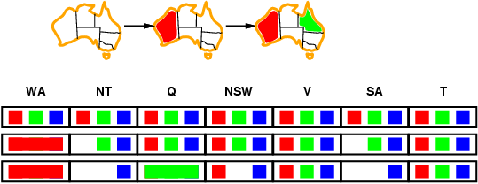
Forward checking
Idea:
Keep track of remaining legal values for unassigned variables
Terminate search when any variable has no legal values

Slide 30
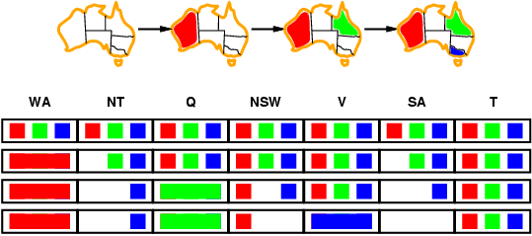
Forward checking
Idea:
Keep track of remaining legal values for unassigned variables
Terminate search when any variable has no legal values

Slide 31
Constraint propagation
Forward checking propagates information from assigned to unassigned variables, but doesn't provide early detection for all failures:
NT and SA cannot both be blue!
Constraint propagation repeatedly enforces constraints locally

Slide 32
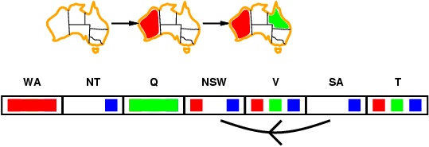
Arc consistency
Simplest form of propagation makes each arc consistent
X →Y is consistent iff
for every value x of X there is some allowed y

Slide 33
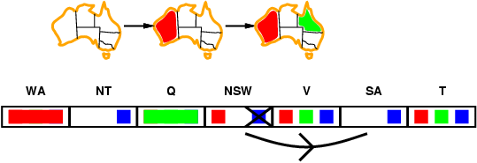
Arc consistency
Simplest form of propagation makes each arc consistent
X →Y is consistent iff
for every value x of X there is some allowed y

Slide 34
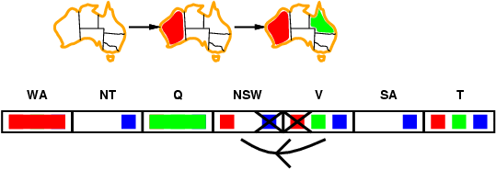
Arc consistency
Simplest form of propagation makes each arc consistent
X →Y is consistent iff
for every value x of X there is some allowed y
If X loses a value, neighbors of X need to be rechecked

Slide 35
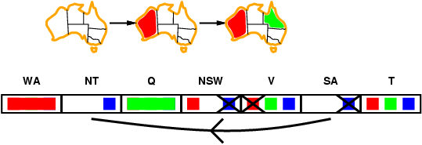
Arc consistency
Simplest form of propagation makes each arc consistent
X →Y is consistent iff
for every value x of X there is some allowed y
If X loses a value, neighbors of X need to be rechecked
Arc consistency detects failure earlier than forward checking
Can be run as a preprocessor or after each assignment

Slide 36
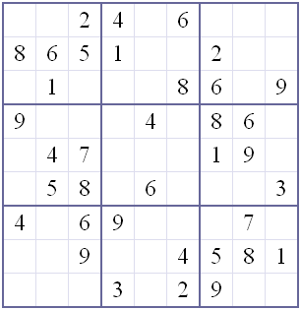
Example: Arc Consistency in Sudoku
Variables: 81 slots
Domains = {1,2,3,4,5,6,7,8,9}
Constraints:
27 not-equal
2 3 4 6
2
Each row, column and major block must be alldifferent
“Well posed” if it has unique solution: 27 constraints

Slide 37
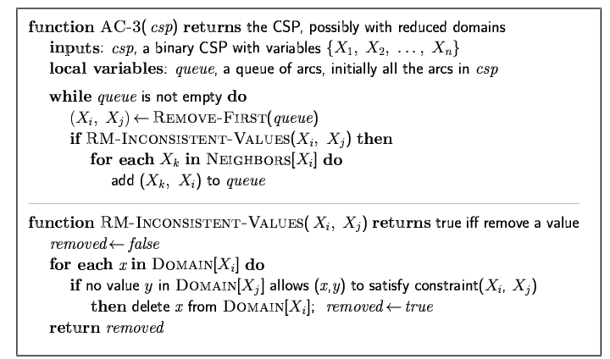
Arc consistency algorithm AC-3
Time complexity: O(n²d³)

Slide 38
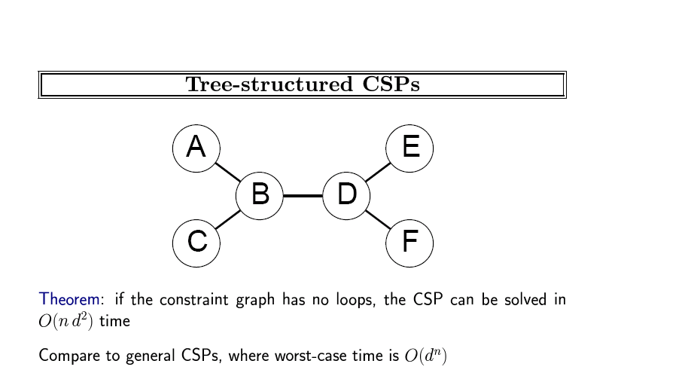

Slide 39
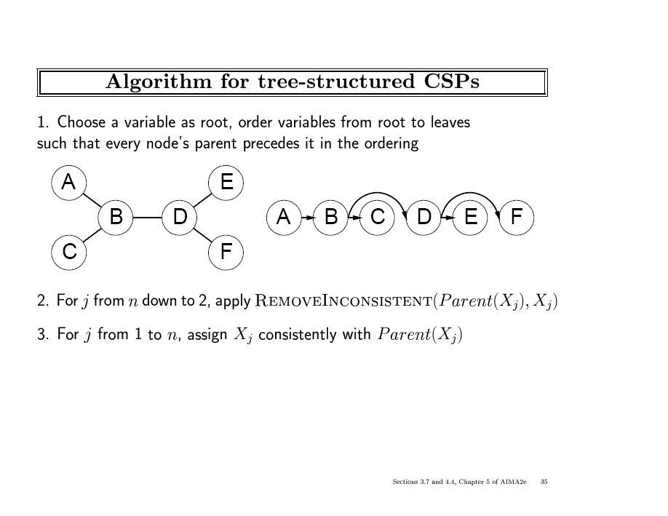

Slide 40
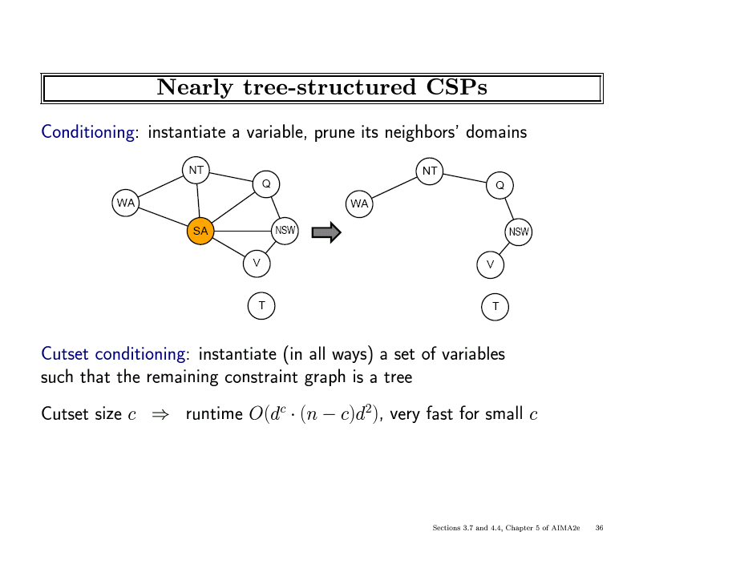

Slide 41
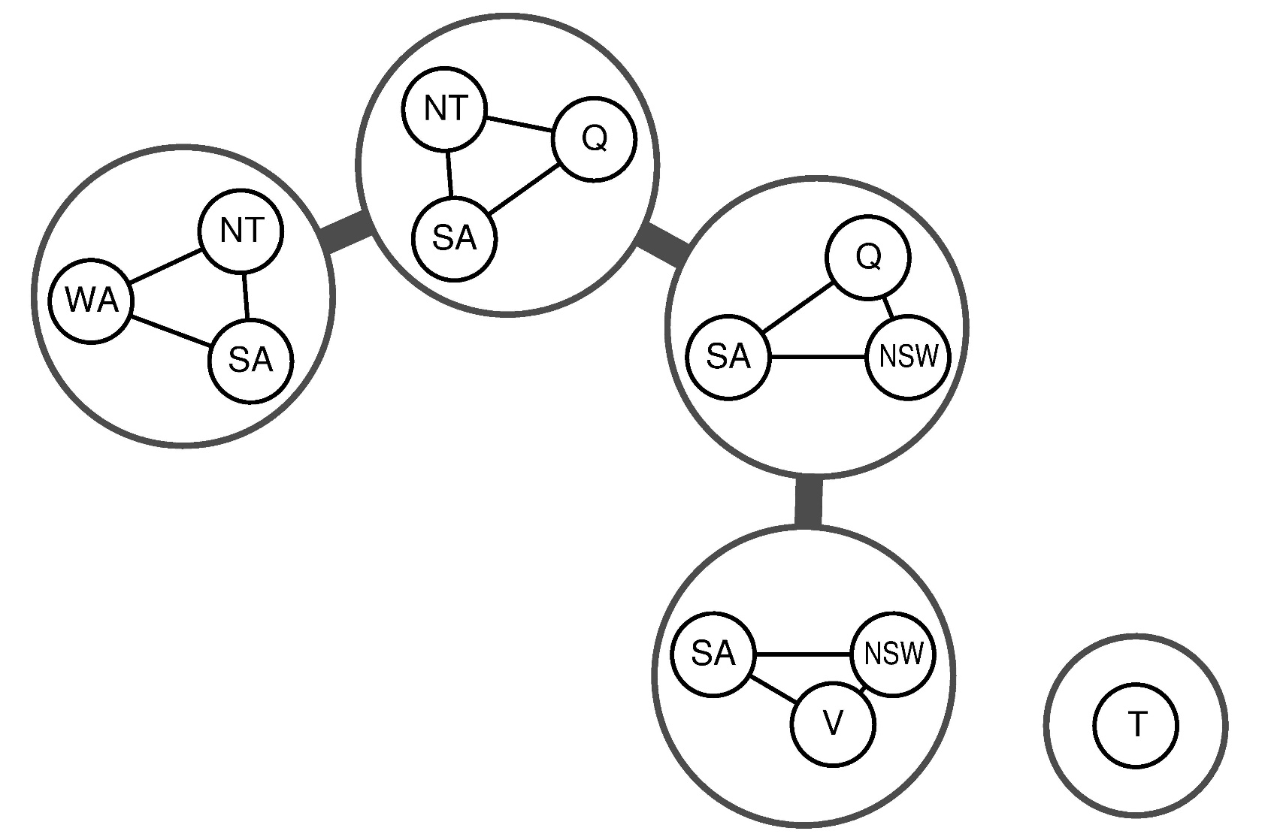
Junction Tree Decompositions

Slide 42
Local search for CSPs
Hill-climbing, simulated annealing typically work with "complete" states, i.e., all variables assigned
To apply to CSPs:
allow states with unsatisfied constraints
operators reassign variable values
Variable selection: randomly select any conflicted variable
Value selection by min-conflicts heuristic:
choose value that violates the fewest constraints
i.e., hill-climb with h(n) = total number of violated constraints

Slide 43
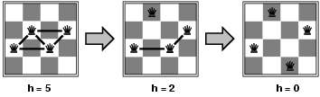
Example: 4-Queens
States: 4 queens in 4 columns (4⁴ = 256 states)
Actions: move queen in column
Goal test: no attacks
Evaluation: h(n) = number of attacks
Given random initial state, can solve n-queens in almost constant time for arbitrary n with high probability (e.g., n = 10,000,000)

Slide 44
Ex: 4-Queens Problem (From Prof. Alexander Ihler slides)
Backtracking search with forward checking
Bookkeeping is tricky & complicated
X1
X2
X3
X4
X1
{1,2,3,4}
X2
{1,2,3,4}
1
2
3
4
X3
{1,2,3,4}
X4
{1,2,3,4}

Slide 45
Ex: 4-Queens Problem
X1
{1,2,3,4}
X2
{1,2,3,4}
X1
X2
X3
X4
1
2
3
4
X3
{1,2,3,4}
X4
{1,2,3,4}
Red = value is assigned to variable

Slide 46
Ex: 4-Queens Problem
X1
{1,2,3,4}
X2
{1,2,3,4}
X1
X2
X3
X4
1
2
3
4
X3
{1,2,3,4}
X4
{1,2,3,4}
Red = value is assigned to variable

Slide 47
Ex: 4-Queens Problem
X1 Level:
Deleted:
{ (X2,1) (X2,2) (X3,1) (X3,3) (X4,1) (X4,4) }
(Please note: As always in computer science, there are many different ways to implement anything. The book-keeping method shown here was chosen because it is easy to present and understand visually. It is not necessarily the most efficient way to implement the book-keeping in a computer. Your job as an algorithm designer is to think long and hard about your problem, then devise an efficient implementation.)
One possibly more efficient equivalent alternative (of many):
Deleted:
{ (X2:1,2) (X3:1,3) (X4:1,4) }

Slide 48
Ex: 4-Queens Problem
X1
{1,2,3,4}
X2
{ , ,3,4}
X1
X2
X3
X4
1
2
3
4
X3
{ ,2, ,4}
X4
{ ,2,3, }
Red = value is assigned to variable

Slide 49
Ex: 4-Queens Problem
X1
{1,2,3,4}
X2
{ , ,3,4}
X1
X2
X3
X4
1
2
3
4
X3
{ ,2, ,4}
X4
{ ,2,3, }
Red = value is assigned to variable

Slide 50
Ex: 4-Queens Problem
X1
{1,2,3,4}
X2
{ , ,3,4}
X1
X2
X3
X4
1
2
3
4
X3
{ ,2, ,4}
X4
{ ,2,3, }
Red = value is assigned to variable

Slide 51
Ex: 4-Queens Problem
X1 Level:
Deleted:
{ (X2,1) (X2,2) (X3,1) (X3,3) (X4,1) (X4,4) }
X2 Level:
Deleted:
{ (X3,2) (X3,4) (X4,3) }
(Please note: Of course, we could have failed as soon as we deleted { (X3,2) (X3,4) }. There was no need to continue to delete (X4,3), because we already had established that the domain of X3 was null, and so we already knew that this branch was futile and we were going to fail anyway. The book-keeping method shown here was chosen because it is easy to present and understand visually. It is not necessarily the most efficient way to implement the book-keeping in a computer. Your job as an algorithm designer is to think long and hard about your problem, then devise an efficient implementation.)

Slide 52
Ex: 4-Queens Problem
X1
{1,2,3,4}
X2
{ , ,3,4}
X1
X2
X3
X4
1
2
3
4
X3
{ , , , }
X4
{ ,2, , }
Red = value is assigned to variable

Slide 53
Ex: 4-Queens Problem
X1 Level:
Deleted:
{ (X2,1) (X2,2) (X3,1) (X3,3) (X4,1) (X4,4) }
X2 Level:
FAIL at X2=3.
Restore:
{ (X3,2) (X3,4) (X4,3) }

Slide 54
Ex: 4-Queens Problem
X1
{1,2,3,4}
X2
{ , ,3,4}
X
X1
X2
X3
X4
1
2
3
4
X3
{ ,2, ,4}
X4
{ ,2,3, }
Red = value is assigned to variable
X = value led to failure

Slide 55
Ex: 4-Queens Problem
X1
{1,2,3,4}
X2
{ , ,3,4}
X
X1
X2
X3
X4
1
2
3
4
X3
{ ,2, ,4}
X4
{ ,2,3, }
Red = value is assigned to variable
X = value led to failure

Slide 56
Ex: 4-Queens Problem
X1
{1,2,3,4}
X2
{ , ,3,4}
X
X1
X2
X3
X4
1
2
3
4
X3
{ ,2, ,4}
X4
{ ,2,3, }
Red = value is assigned to variable
X = value led to failure

Slide 57
Ex: 4-Queens Problem
X1 Level:
Deleted:
{ (X2,1) (X2,2) (X3,1) (X3,3) (X4,1) (X4,4) }
X2 Level:
Deleted:
{ (X3,4) (X4,2) }

Slide 58
Ex: 4-Queens Problem
X1
{1,2,3,4}
X2
{ , ,3,4}
X
X1
X2
X3
X4
1
2
3
4
X3
{ ,2, , }
X4
{ , ,3, }
Red = value is assigned to variable
X = value led to failure

Slide 59
Ex: 4-Queens Problem
X1
{1,2,3,4}
X2
{ , ,3,4}
X
X1
X2
X3
X4
1
2
3
4
X3
{ ,2, , }
X4
{ , ,3, }
Red = value is assigned to variable
X = value led to failure

Slide 60
Ex: 4-Queens Problem
X1
{1,2,3,4}
X2
{ , ,3,4}
X
X1
X2
X3
X4
1
2
3
4
X3
{ ,2, , }
X4
{ , ,3, }
Red = value is assigned to variable
X = value led to failure

Slide 61
Ex: 4-Queens Problem
X1 Level:
Deleted:
{ (X2,1) (X2,2) (X3,1) (X3,3) (X4,1) (X4,4) }
X2 Level:
Deleted:
{ (X3,4) (X4,2) }
X3 Level:
Deleted:
{ (X4,3) }

Slide 62
Ex: 4-Queens Problem
X1
{1,2,3,4}
X2
{ , ,3,4}
X
X1
X2
X3
X4
1
2
3
4
X3
{ ,2, , }
X4
{ , , , }
Red = value is assigned to variable
X = value led to failure

Slide 63
Ex: 4-Queens Problem
X1 Level:
Deleted:
{ (X2,1) (X2,2) (X3,1) (X3,3) (X4,1) (X4,4) }
X2 Level:
Deleted:
{ (X3,4) (X4,2) }
X3 Level:
Fail at X3=2.
Restore:
{ (X4,3) }

Slide 64
Ex: 4-Queens Problem
X1
{1,2,3,4}
X2
{ , ,3,4}
X
X1
X2
X3
X4
1
2
3
4
X3
{ ,2, , }
X4
{ , ,3, }
X
Red = value is assigned to variable
X = value led to failure

Slide 65
Ex: 4-Queens Problem
X1 Level:
Deleted:
{ (X2,1) (X2,2) (X3,1) (X3,3) (X4,1) (X4,4) }
X2 Level:
Fail at X2=4.
Restore:
{ (X3,4) (X4,2) }

Slide 66
Ex: 4-Queens Problem
X1
{1,2,3,4}
X2
{ , ,3,4}
X
X
X1
X2
X3
X4
1
2
3
4
X3
{ ,2, ,4}
X4
{ ,2,3, }
Red = value is assigned to variable
X = value led to failure

Slide 67
Ex: 4-Queens Problem
X1 Level:
Fail at X1=1.
Restore:
{ (X2,1) (X2,2) (X3,1) (X3,3) (X4,1) (X4,4) }

Slide 68
Ex: 4-Queens Problem
X1
{1,2,3,4}
X2
{1,2,3,4}
X
X1
X2
X3
X4
1
2
3
4
X3
{1,2,3,4}
X4
{1,2,3,4}
Red = value is assigned to variable
X = value led to failure

Slide 69
Ex: 4-Queens Problem
X1
{1,2,3,4}
X2
{1,2,3,4}
X
X1
X2
X3
X4
1
2
3
4
X3
{1,2,3,4}
X4
{1,2,3,4}
Red = value is assigned to variable
X = value led to failure

Slide 70
Ex: 4-Queens Problem
X1
{1,2,3,4}
X2
{1,2,3,4}
X
X1
X2
X3
X4
1
2
3
4
X3
{1,2,3,4}
X4
{1,2,3,4}
Red = value is assigned to variable
X = value led to failure

Slide 71
Ex: 4-Queens Problem
X1 Level:
Deleted:
{ (X2,1) (X2,2) (X2,3) (X3,2) (X3,4) (X4,2) }

Slide 72
Ex: 4-Queens Problem
X1
{1,2,3,4}
X2
{ , , ,4}
X
X1
X2
X3
X4
1
2
3
4
X3
{1, ,3, }
X4
{1, ,3,4}
Red = value is assigned to variable
X = value led to failure

Slide 73
Ex: 4-Queens Problem
X1
{1,2,3,4}
X2
{ , , ,4}
X
X1
X2
X3
X4
1
2
3
4
X3
{1, ,3, }
X4
{1, ,3,4}
Red = value is assigned to variable
X = value led to failure

Slide 74
Ex: 4-Queens Problem
X1
{1,2,3,4}
X2
{ , , ,4}
X
X1
X2
X3
X4
1
2
3
4
X3
{1, ,3, }
X4
{1, ,3,4}
Red = value is assigned to variable
X = value led to failure

Slide 75
Ex: 4-Queens Problem
X1 Level:
Deleted:
{ (X2,1) (X2,2) (X2,3) (X3,2) (X3,4) (X4,2) }
X2 Level:
Deleted:
{ (X3,3) (X4,4) }

Slide 76
Ex: 4-Queens Problem
X1
{1,2,3,4}
X2
{ , , ,4}
X
X1
X2
X3
X4
1
2
3
4
X3
{1, , , }
X4
{1, ,3, }
Red = value is assigned to variable
X = value led to failure

Slide 77
Ex: 4-Queens Problem
X1
{1,2,3,4}
X2
{ , , ,4}
X
X1
X2
X3
X4
1
2
3
4
X3
{1, , , }
X4
{1, ,3, }
Red = value is assigned to variable
X = value led to failure

Slide 78
Ex: 4-Queens Problem
X1
{1,2,3,4}
X2
{ , , ,4}
X
X1
X2
X3
X4
1
2
3
4
X3
{1, , , }
X4
{1, ,3, }
Red = value is assigned to variable
X = value led to failure

Slide 79
Ex: 4-Queens Problem
X1 Level:
Deleted:
{ (X2,1) (X2,2) (X2,3) (X3,2) (X3,4) (X4,2) }
X2 Level:
Deleted:
{ (X3,3) (X4,4) }
X3 Level:
Deleted:
{ (X4,1) }

Slide 80
Ex: 4-Queens Problem
X1
{1,2,3,4}
X2
{ , , ,4}
X
X1
X2
X3
X4
1
2
3
4
X3
{1, , , }
X4
{ , ,3, }
Red = value is assigned to variable
X = value led to failure

Slide 81
Ex: 4-Queens Problem
X1
{1,2,3,4}
X2
{ , , ,4}
X
X1
X2
X3
X4
1
2
3
4
X3
{1, , , }
X4
{ , ,3, }
Red = value is assigned to variable
X = value led to failure

Slide 82
Summary
CSPs are a special kind of problem:
states defined by values of a fixed set of variables
goal test defined by constraints on variable values
Backtracking = depth-first search with one variable assigned per node
Variable ordering and value selection heuristics help significantly
Forward checking prevents assignments that guarantee later failure
Constraint propagation (e.g., arc consistency) does additional work to constrain values and detect inconsistencies
Iterative min-conflicts is usually effective in practice

